Slide 1
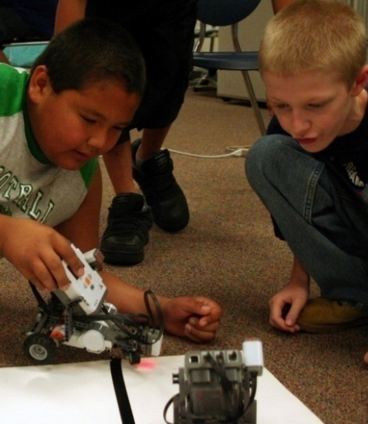
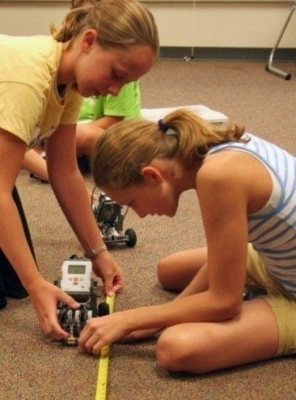
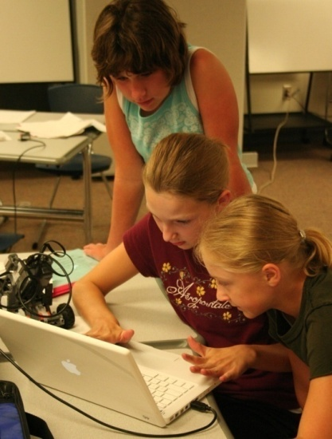

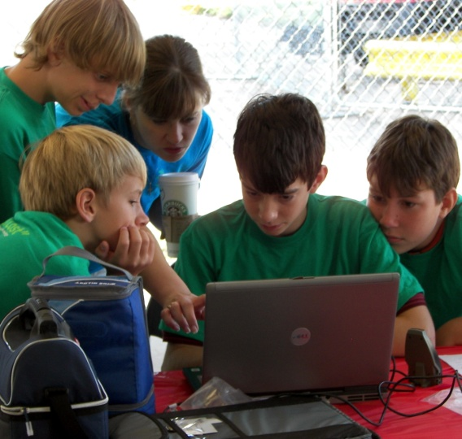




Measuring the Impact of Robotics and GIS/GPS on Youth STEM Attitudes
Gwen Nugent, Bradley Barker,
Michael Toland, Neal Grandgenett, Slava Adumchuk
Notes:
1

Slide 2

4
Conducted in after-school settings and 4-H clubs
Developed for middle school students
Involves week-long intensive summer camp
  Youth build and program robots (LEGO NXT Mindstorms), work with hand-held GPS devices, and develop GIS maps

Slide 3
Research
Purpose: To investigate the impact of the program in promoting STEM learning and impacting STEM attitudes

Slide 4

STEM Learning
Four studies showed significant increases in student learning of:
  Computer programming
  Mathematics
  Geospatial concepts
  Engineering/robotics

Slide 5
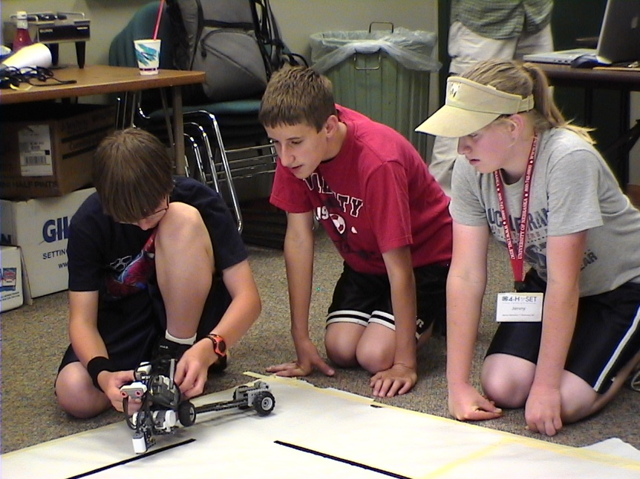
STEM Attitudes
Studies of STEM attitudes showed no increases:
  Use of existing instruments
  revealed alignment
  problems
  High pre-test scores
Led to development of
new instrument

Slide 6

Underlying Constructs: Motivation
Task Value
  Math - It is important for me to learn
  how to use mathematical formulas to
  help solve practical problems.
  Science - I like using the scientific
  method to solve problems.
  GPS/GIS - I like learning new
  technologies like GPS.
  Robotics - It is important for me to learn
  about robotics.

Slide 7
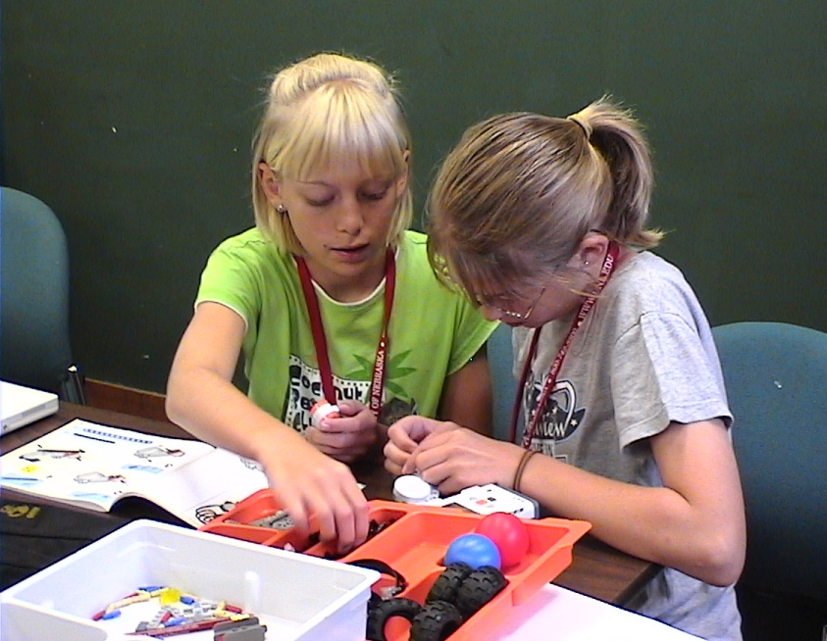
Underlying Constructs: Motivation
Self-efficacy
  I am certain I can build a LEGO
  robot by following design
  instructions.
  I am confident that I can
  make a digital map.

Slide 8
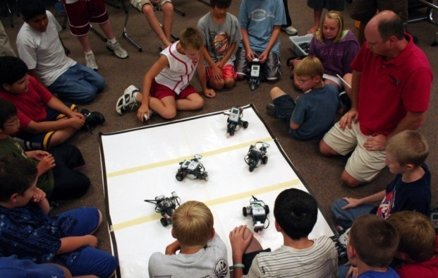
Underlying Constructs: Learning Strategies
Teamwork
  I like to work with others
  to complete projects.
Problem solving
  I make a plan before I
  start to solve a problem.

Slide 9
Confirmatory Factor Analysis
Sample
  514 Nebraska students aged 11 – 15 years
  Equal percentage of male and female
  Primarily Caucasian (95%)
  Drawn primarily from rural schools

Slide 10
Confirmatory Factor Analysis
CFA model examined item loadings and fit statistics
  Fit indices: Chi-square test, standardized root mean squared residual, root mean square of estimation, comparative fit index

Slide 11
CFA Results
Measure | Chi-square (df) | SRMR | RMSEA | CFI | α
Motivation: Task Value | 161.2 (59), p < .001 | .048** | .061* | .942*
Science/ Math |  |  |  |  | .64
GPS/GIS |  |  |  |  | .78
Robotics |  |  |  |  | .80
Self-efficacy |  |  |  |  | .77
Learning | 85.93 (41), p < .001 | .053** | .048** | .951**
Problem Approach |  |  |  |  | .64
Teamwork |  |  |  |  | .72
**Meets acceptable fit criteria * Close to acceptable fit criteria

Slide 12
Revisions to Instrument
Concern that some scales within motivation construct were under identified
  Low α on science/math task value led to splitting into two separate scales
  Task value items revised to use parallel language to probe “importance” and “liking”
  Self-efficacy scale was split into two scales for robotics and GPS/GIS
Final instrument contains 33 items, 8 scales, with 4 to 5 items per scale

Slide 13
Results from Use of
New Instrument
Summer 2008 camps
  147 youth in six camps
  112 males and 35 females
  75% Caucasian
  Mean age 12.28 years
Dependent t-tests run for pre to post total and scale scores

Slide 14
Results: Motivation
Measure | M (pre) | M (post) | t(df) | p-value (one tail) | α
Motivation
Task Value
Science | 4.04 | 4.20 | 4.15 (133) | p < .001 | .75
Math | 4.03 | 4.14 | 2.06 (133) | p < .05 | .83
Robotics | 4.34 | 4.41 | 1.65 (133) | p = .05 | .83
GPS/GIS | 4.11 | 4.11 | .02 (133) | p = .49 | .86
Self-efficacy
Robotics | 4.10 | 4.54 | 7.31(129) | p < .001 | .64
GPS/GIS | 4.01 | 4.39 | 5.84 (129) | p < .001 | .72

Slide 15
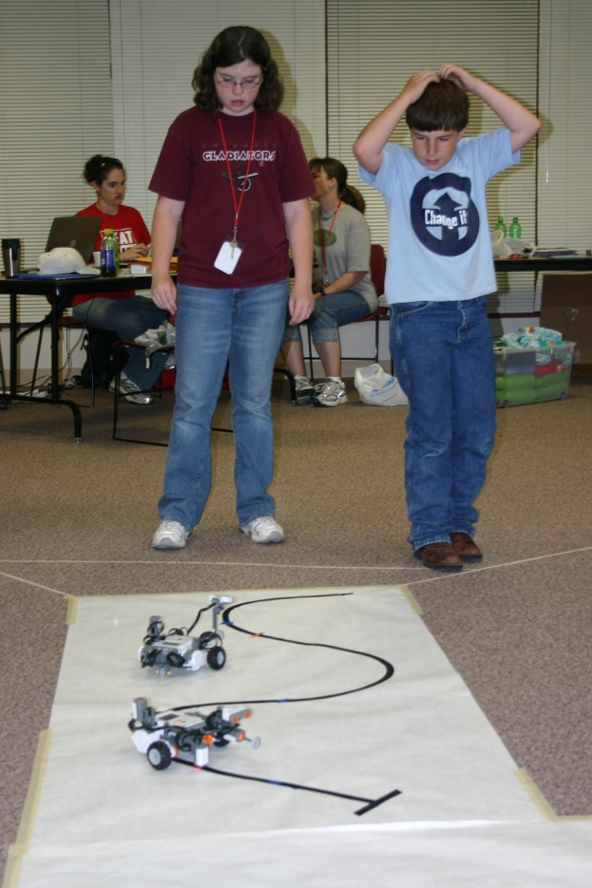
Results: Motivation
Youth increased their
perceived value of math,
science, and robotics.
Perceived value of
GPS/GIS did not increase,
but their confidence in
using GPS/GIS did.
Confidence in robotics skills
increased.

Slide 16
Results: Learning Strategies
Measure | M (pre) | M (post) | t(df) | p-value (one tail) | α
Learning Strategies
Problem Approach | 3.83 | 3.96 | 2.41(133) | p< .01 | .80
Teamwork | 4.08 | 4.07 | .13 (129) | p= .448 | .88
Total Attitude | 147.52 | 155.91 | 5.09(133) | p< .001 | .95

Slide 17
Results: Learning Strategies
Students increased in their problem solving skills
Teamwork skills did not increase, leading to follow-up gender analyses
  Follow-up analysis used split plot design with time (pre-post) as within subject variable and gender as between subject variable

Slide 18
Results by Gender
Robotics Task Value (significant interaction)

Slide 19
Results by Gender

Slide 20
Results by Gender

Slide 21
Summary and Discussion
Attitudinal improvements in several key areas have been documented.
Comparisons with a control group also show significantly higher attitude scores for robotics group.
New research has shown that even short-term robotics interventions can influence youth attitudes.

Slide 22
Summary and Discussion
Alignment of attitude instrument with nature of instructional program is critical.
  Instead of science is good for everybody, use it is important for me to learn how to collect and interpret data.
  Self-efficacy items focus on program-related tasks.

Slide 23
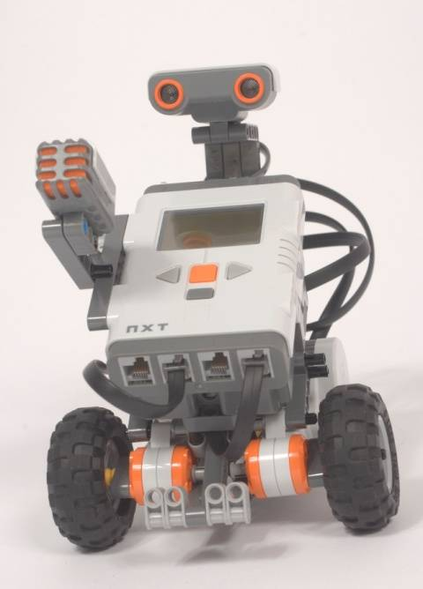
Summary and Discussion
Our instrument may provide a template for other researchers interested in measuring STEM attitudes

